Slide 1
大数据
在心血管疾病防控中的价值
首都医科大学附属北京安贞医院
杜昕
Notes:
左上角logo不匹配，依托单位的logo要找出来。

Slide 2
大数据时代的到来
数据量增加
ZB
数据量呈指数级增长
最近两年产生的数据量相当于之前产生的全部数据量
McKinsey & Co. Report 2011

Slide 3
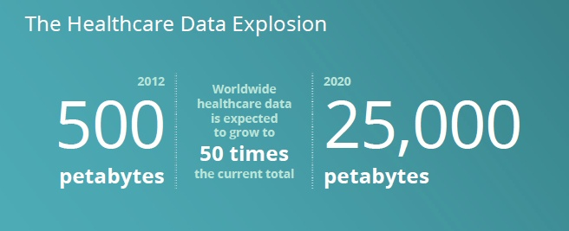
大数据平台关乎国家战略
2012年3月22日，美国启动“大数据国家战略计划”，奥巴马政府将大数据比喻为新的“石油”
大数据是新一轮的技术革命，比肩80年代个人电脑、90年代互联网和当今的智能手机
2012
2020
2012~2020年世界范围内健康数据增长50倍

Slide 4

大数据的特征: Volume、Velocity、Variety
类型多样
结构化和非结构化数据：
文本、语音、影像、数据流量
速度快捷
时间敏感性，能对数据流变化快捷反应
容量庞大
以PB记（1PB=1024TB）

Slide 5
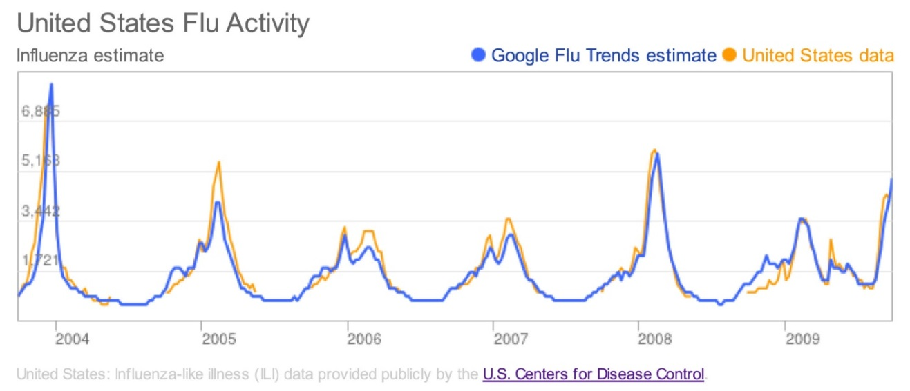
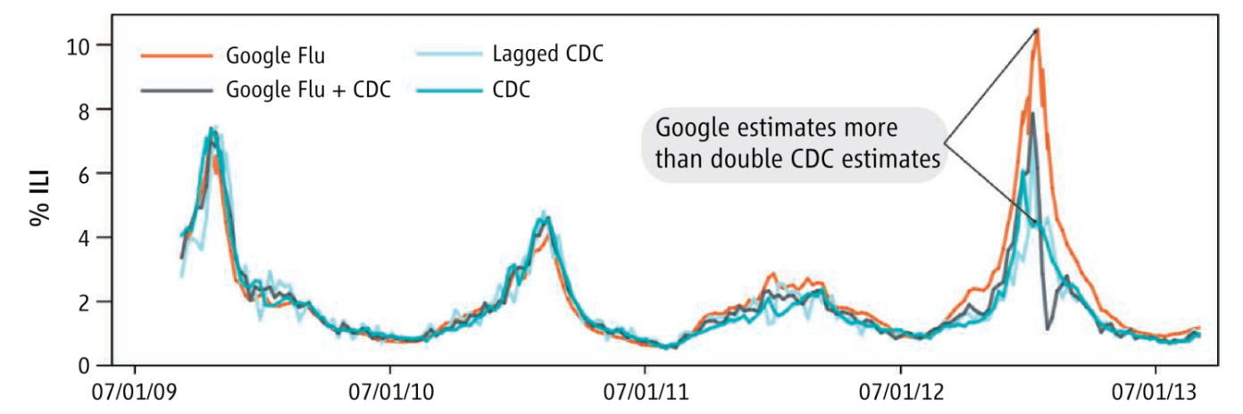
Google搜索对流感趋势的预测
Nature. 2009;457:1012
Science. 2013;343:1203
Google搜索预测流感流行趋势与美国CDC监测数据吻合，并提前1周预测流感爆发高峰期

Slide 6
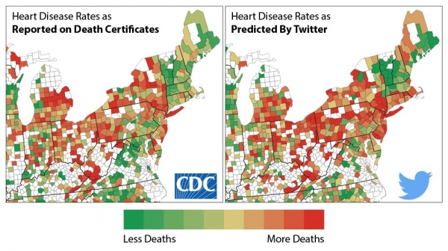
Twitter对心脏病死亡的预测
happier language about happier topics associated with lower rates of heart disease death；angry language about negative topics associated with higher rates.
Psychol Sci. 2015; Epub
Notes:
Psychol Sci. 2015 Jan 20. pii: 0956797614557867. [Epub ahead of print]
Psychological Language on Twitter Predicts County-Level Heart Disease Mortality.
Eichstaedt JC1, Schwartz HA2, Kern ML3, Park G4, Labarthe DR5, Merchant RM6, Jha S7, Agrawal M7, Dziurzynski LA4, Sap M4, Weeg C4, Larson EE4, Ungar LH2, Seligman ME4.
Author information
Abstract
Hostility and chronic stress are known risk factors for heart disease, but they are costly to assess on a large scale. We used language expressed on Twitter to characterize community-level psychological correlates of age-adjusted mortality from atherosclerotic heart disease (AHD). Language patterns reflecting negative social relationships, disengagement, and negative emotions-especially anger-emerged as risk factors; positive emotions and psychological engagement emerged as protective factors. Most correlations remained significant after controlling for income and education. A cross-sectional regression model based only on Twitter language predicted AHD mortality significantly better than did a model that combined 10 common demographic, socioeconomic, and health risk factors, including smoking, diabetes, hypertension, and obesity. Capturing community psychological characteristics through social media is feasible, and these characteristics are strong markers of cardiovascular mortality at the community level.

Slide 7
Big Data to Knowledge（BD2K）
NIH将支持研究、应用和培训现有数据科学
BD2K将开发新的方法、标准、工具、软件，加强生物医学大数据的应用
  获取共享的生物医学数据，促进数据共享、挖掘、存储管理和应用
  研发大数据处理、存储、分析、集成和可视化等
  保护隐私和知识产权
  培养一支熟练应用大数据的研究团队
http://bd2k.nih.gov/about_bd2k.html#bigdata

Slide 8

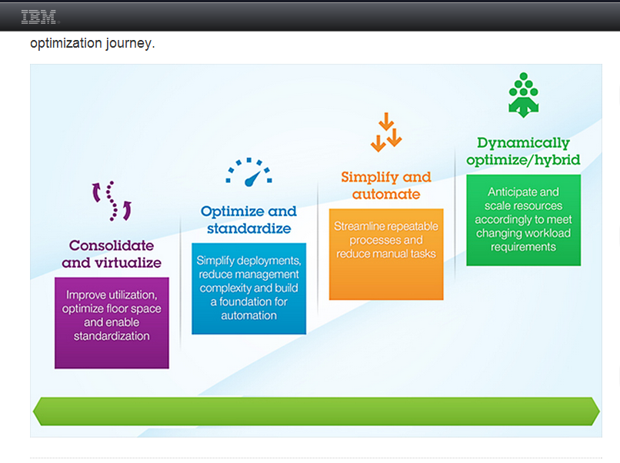
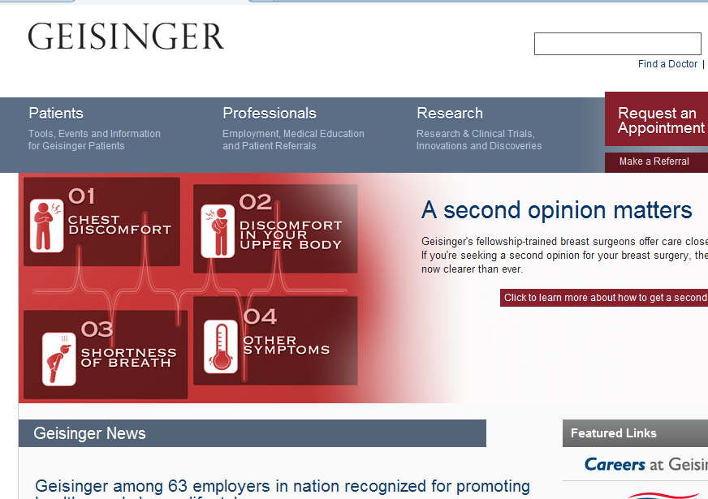
NIH支持大数据项目
2013年10月9日NIH宣布支持Sutter Health, IBM和Geisinger Health System
研究大数据用于心力衰竭早期预警

Slide 9

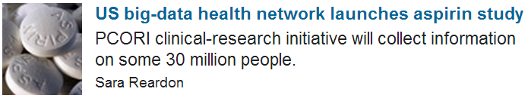

美国国家临床研究网络
0.68亿美元建立国家临床研究网络
2014年7月美国PCORI 投票表决通过的第一个临床大数据研究项目
2014 Aug 7;512:18

Slide 10
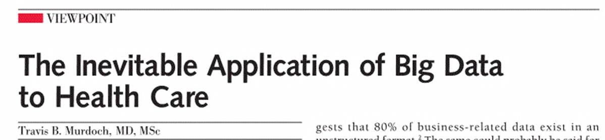
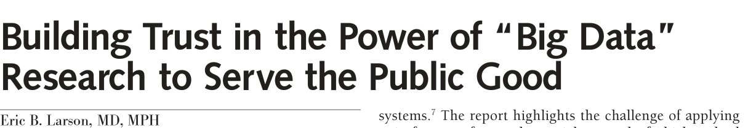
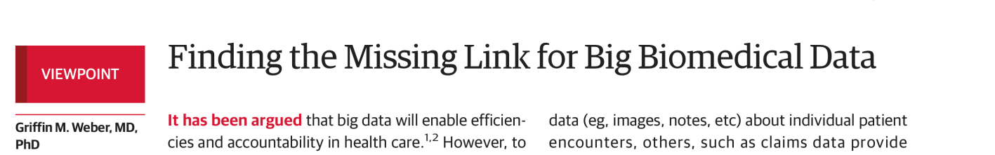
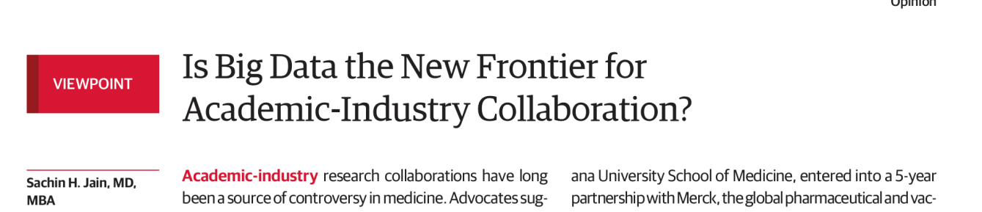
健康服务是大数据应用最重要的领域之一
JAMA. 2013;309:1351
JAMA. 2013;309:2443
JAMA. 2014;Epub
JAMA. 2014;Epub

Slide 11

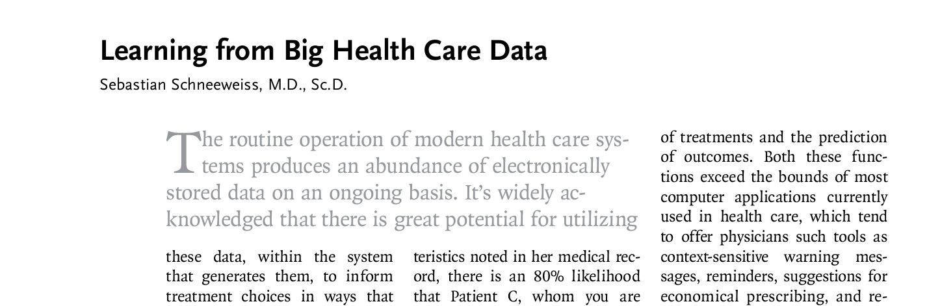
建立健康大数据平台
打破壁垒，链接数据孤岛
N Engl J Med. 2014;370:2161
Notes:
N Engl J Med. 2014 Jun 5;370(23):2161-3. doi: 10.1056/NEJMp1401111.
Learning from big health care data.
Schneeweiss S.
Author information
PMID: 24897079 [PubMed - indexed for MEDLINE] Free full text
MeSH Terms

Slide 12
临床研究数据库
英国CPRD
英国临床研究数据库（Clinical Practice Research Datalink）是2011年NHS和MHRA资助的数据库整合项目，包括以下数据资源：
  社区用药数据
  医院内用药数据
  实验室检查数据
  医院疾病编码数据
  健康咨询数据
  疾病注册数据
  癌症数据
1998-2013，CPRD发表890篇研究论文，其中半数是近三年发表
JAMA 10篇，Lancet 16篇，BMJ 33篇
http://www.cprd.com

Slide 13
临床研究数据库
瑞典数据库
瑞典基于人群的登记和全国强制性医疗登记，为临床研究创造了独特的条件
基于人群的登记：
社会经济学变量登记
瑞典社会保险登记
基于医疗的登记：
患者登记
用药登记
死因登记
癌症登记
EMR
100多种疾病全国登记
http://www.iwh.on.ca/wrmb/data-linkage

Slide 14
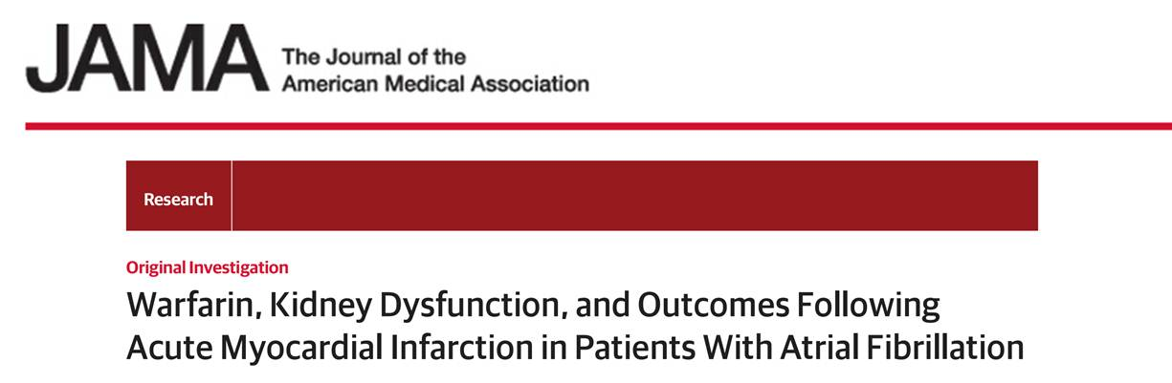
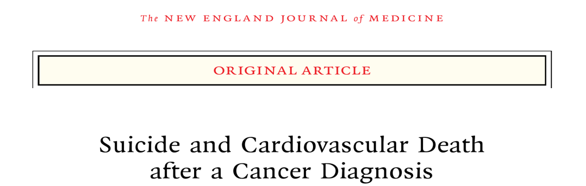
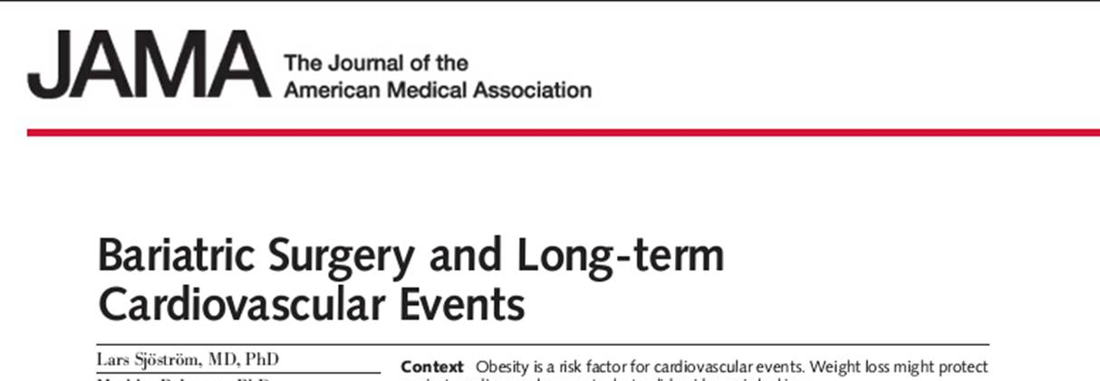
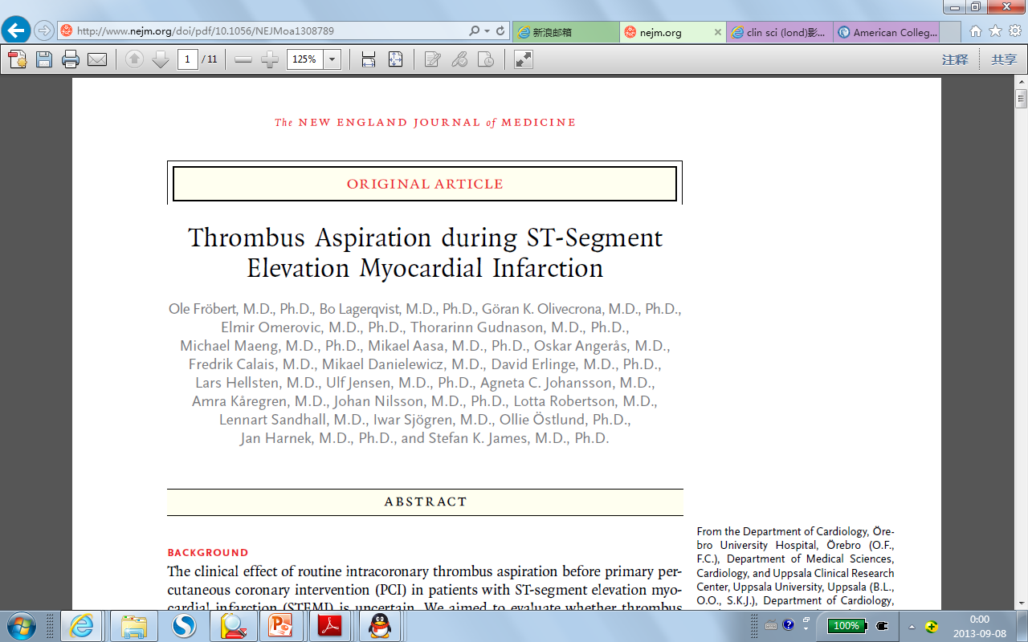
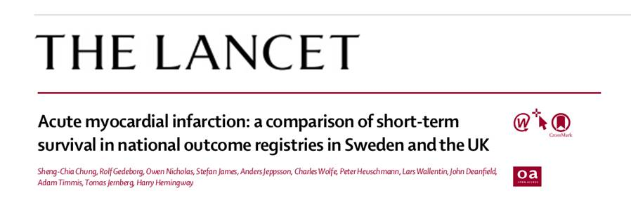
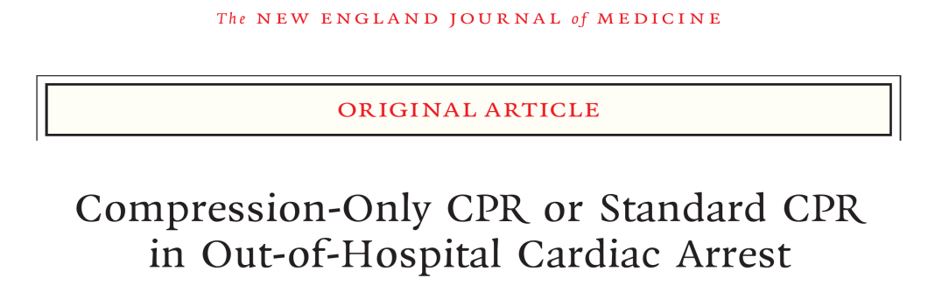
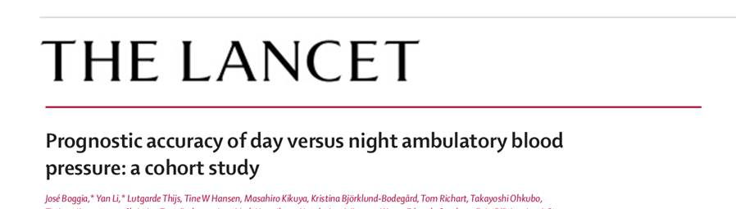
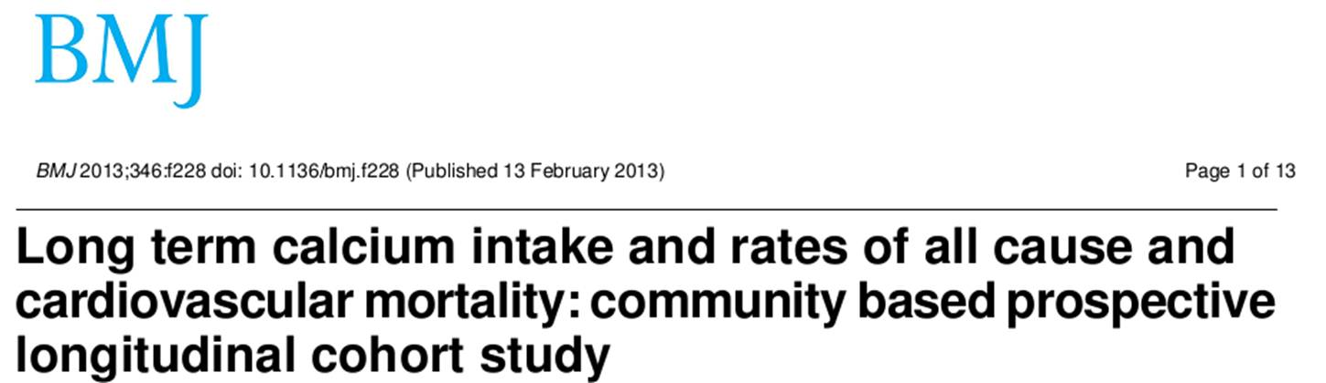
瑞典临床研究数据库代表性产出

Slide 15
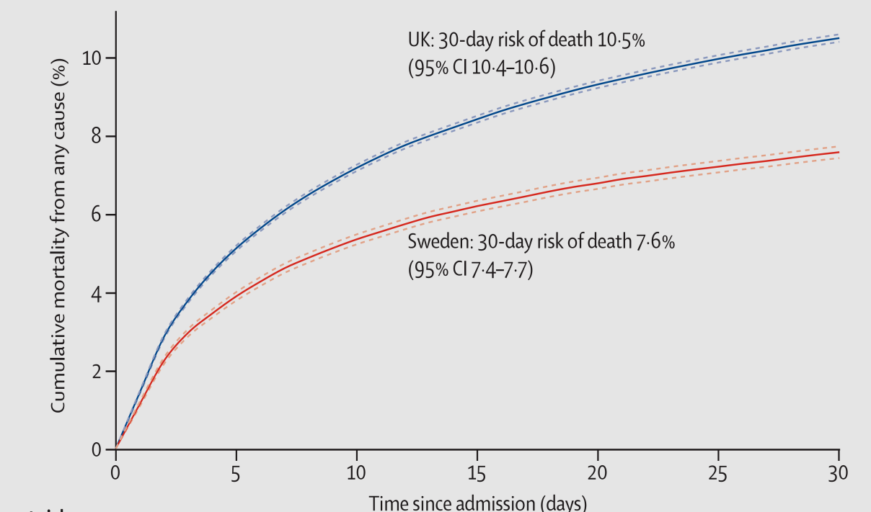
大数据平台支持临床实效研究
接受AMI患者的医院
英国242家
瑞典86家
英国和瑞典急性心梗30天死亡率比较(2004-2010)
所有患者的入院记录
英国739,828例
瑞典414,831例
AMI患者入院记录
英国391,077例
瑞典119,786例
30天死亡
英国41,509例
瑞典9,173例
30天死亡率瑞典7.6%，英国10.5%
Lancet. 2014;383:1305

Slide 16
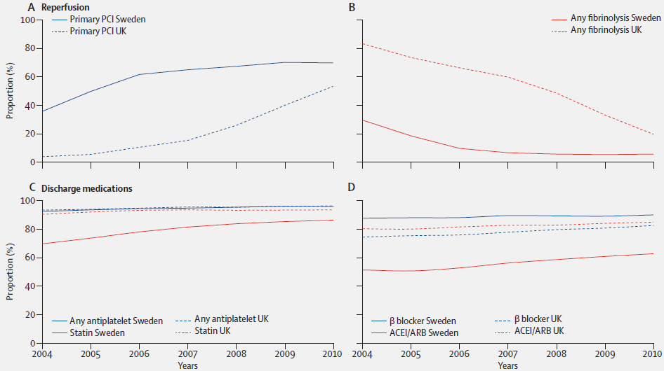
大数据平台支持临床实效研究
瑞典急诊PCI和β受体阻滞剂应用率显著高于英国
可能是瑞典心肌梗死后死亡率低的原因
Lancet. 2014;383:1305

Slide 17
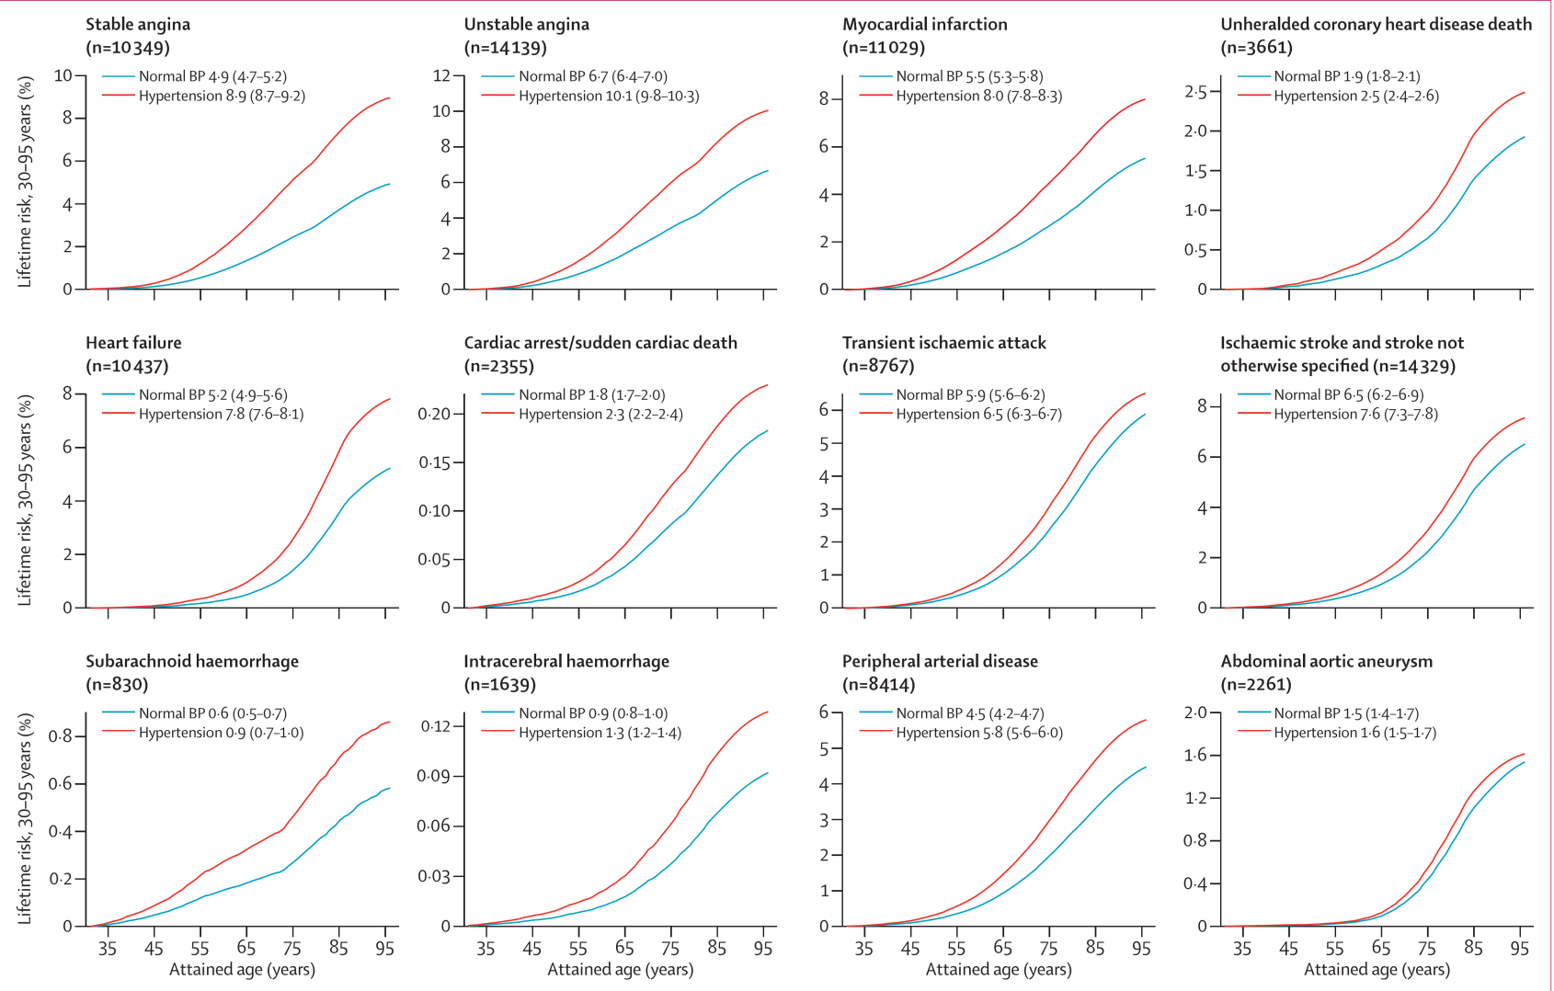
大数据平台支持临床实效研究
英国CPRD、心肌梗死数据库、住院数据库、死因数据库四大数据库整合，125万患者
高血压对不同疾病影响差异大，降压无“J型曲线”
Lancet. 2014;383:1899
Notes:
Lancet. 2014 May 31;383(9932):1899-911. doi: 10.1016/S0140-6736(14)60685-1.
Blood pressure and incidence of twelve cardiovascular diseases: lifetime risks, healthy life-years lost, and age-specific associations in 1·25 million people.
Rapsomaniki E1, Timmis A2, George J3, Pujades-Rodriguez M3, Shah AD3, Denaxas S3, White IR4, Caulfield MJ5, Deanfield JE6, Smeeth L7, Williams B8, Hingorani A3, Hemingway H3.
Author information
Abstract
BACKGROUND:
The associations of blood pressure with the different manifestations of incident cardiovascular disease in a contemporary population have not been compared. In this study, we aimed to analyse the associations of blood pressure with 12 different presentations of cardiovascular disease.
METHODS:
We used linked electronic health records from 1997 to 2010 in the CALIBER (CArdiovascular research using LInked Bespoke studies and Electronic health Records) programme to assemble a cohort of 1·25 million patients, 30 years of age or older and initially free from cardiovascular disease, a fifth of whom received blood pressure-lowering treatments. We studied the heterogeneity in the age-specific associations of clinically measured blood pressure with 12 acute and chronic cardiovascular diseases, and estimated the lifetime risks (up to 95 years of age) and cardiovascular disease-free life-years lost adjusted for other risk factors at index ages 30, 60, and 80 years. This study is registered at ClinicalTrials.gov, number NCT01164371.
FINDINGS:
During 5·2 years median follow-up, we recorded 83,098 initial cardiovascular disease presentations. In each age group, the lowest risk for cardiovascular disease was in people with systolic blood pressure of 90-114 mm Hg and diastolic blood pressure of 60-74 mm Hg, with no evidence of a J-shaped increased risk at lower blood pressures. The effect of high blood pressure varied by cardiovascular disease endpoint, from strongly positive to no effect. Associations with high systolic blood pressure were strongest for intracerebral haemorrhage (hazard ratio 1·44 [95% CI 1·32-1·58]), subarachnoid haemorrhage (1·43 [1·25-1·63]), and stable angina (1·41 [1·36-1·46]), and weakest for abdominal aortic aneurysm (1·08 [1·00-1·17]). Compared with diastolic blood pressure, raised systolic blood pressure had a greater effect on angina, myocardial infarction, and peripheral arterial disease, whereas raised diastolic blood pressure had a greater effect on abdominal aortic aneurysm than did raised systolic pressure. Pulse pressure associations were inverse for abdominal aortic aneurysm (HR per 10 mm Hg 0·91 [95% CI 0·86-0·98]) and strongest for peripheral arterial disease (1·23 [1·20-1·27]). People with hypertension (blood pressure ≥140/90 mm Hg or those receiving blood pressure-lowering drugs) had a lifetime risk of overall cardiovascular disease at 30 years of age of 63·3% (95% CI 62·9-63·8) compared with 46·1% (45·5-46·8) for those with normal blood pressure, and developed cardiovascular disease 5·0 years earlier (95% CI 4·8-5·2). Stable and unstable angina accounted for most (43%) of the cardiovascular disease-free years of life lost associated with hypertension from index age 30 years, whereas heart failure and stable angina accounted for the largest proportion (19% each) of years of life lost from index age 80 years.
INTERPRETATION:
The widely held assumptions that blood pressure has strong associations with the occurrence of all cardiovascular diseases across a wide age range, and that diastolic and systolic associations are concordant, are not supported by the findings of this high-resolution study. Despite modern treatments, the lifetime burden of hypertension is substantial. These findings emphasise the need for new blood pressure-lowering strategies, and will help to inform the design of randomised trials to assess them.

Slide 18
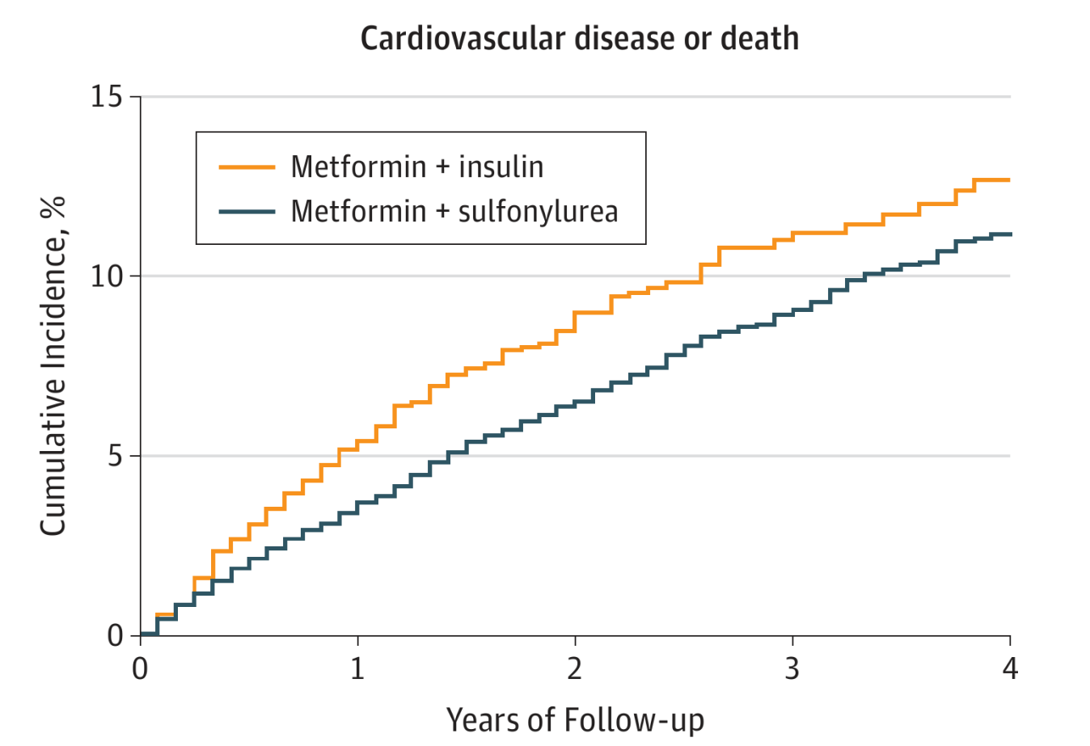
大数据平台支持临床实效研究
美国退伍军人、医保和死因数据库
PS配对
2436例二甲双胍联合胰岛素vs 12180例二甲双胍联合磺脲类
二甲双胍+胰岛素vs +磺脲类全因死亡率（33.7 vs 22.7/1000人年，HR=1.44），AMI+脑卒中+心血管死亡（ 22.8 vs 22.5/1000）
JAMA. 2014;311:2288
Notes:
JAMA. 2014 Jun 11;311(22):2288-96. doi: 10.1001/jama.2014.4312.
Association between intensification of metformin treatment with insulin vs sulfonylureas and cardiovascular events and all-cause mortality among patients with diabetes.
Roumie CL1, Greevy RA2, Grijalva CG3, Hung AM1, Liu X2, Murff HJ1, Elasy TA1, Griffin MR4.
Author information
Abstract
IMPORTANCE:
Preferred second-line medication for diabetes treatment after metformin failure remains uncertain.
OBJECTIVE:
To compare time to acute myocardial infarction (AMI), stroke, or death in a cohort of metformin initiators who added insulin or a sulfonylurea.
DESIGN, SETTING, AND PARTICIPANTS:
Retrospective cohort constructed with national Veterans Health Administration, Medicare, and National Death Index databases. The study population comprised veterans initially treated with metformin from 2001 through 2008 who subsequently added either insulin or sulfonylurea. Propensity score matching on characteristics was performed, matching each participant who added insulin to 5 who added a sulfonylurea. Patients were followed through September 2011 for primary analyses or September 2009 for cause-of-death analyses.
MAIN OUTCOMES AND MEASURES:
Risk of a composite outcome of AMI, stroke hospitalization, or all-cause death was compared between therapies with marginal structural Cox proportional hazard models adjusting for baseline and time-varying demographics, medications, cholesterol level, hemoglobin A1c level, creatinine level, blood pressure, body mass index, and comorbidities.
RESULTS:
Among 178,341 metformin monotherapy patients, 2948 added insulin and 39,990 added a sulfonylurea. Propensity score matching yielded 2436 metformin + insulin and 12,180 metformin + sulfonylurea patients. At intensification, patients had received metformin for a median of 14 months (IQR, 5-30), and hemoglobin A1c level was 8.1% (IQR, 7.2%-9.9%). Median follow-up after intensification was 14 months (IQR, 6-29 months). There were 172 vs 634 events for the primary outcome among patients who added insulin vs sulfonylureas, respectively (42.7 vs 32.8 events per 1000 person-years; adjusted hazard ratio [aHR], 1.30; 95% CI, 1.07-1.58; P = .009). Acute myocardial infarction and stroke rates were statistically similar, 41 vs 229 events (10.2 and 11.9 events per 1000 person-years; aHR, 0.88; 95% CI, 0.59-1.30; P = .52), whereas all-cause death rates were 137 vs 444 events, respectively (33.7 and 22.7 events per 1000 person-years; aHR, 1.44; 95% CI, 1.15-1.79; P = .001). There were 54 vs 258 secondary outcomes: AMI, stroke hospitalizations, or cardiovascular deaths (22.8 vs 22.5 events per 1000 person-years; aHR, 0.98; 95% CI, 0.71-1.34; P = .87).
CONCLUSIONS AND RELEVANCE:
Among patients with diabetes who were receiving metformin, the addition of insulin vs a sulfonylurea was associated with an increased risk of a composite of nonfatal cardiovascular outcomes and all-cause mortality. These findings require further investigation to understand risks associated with insulin use in these patients.

Slide 19
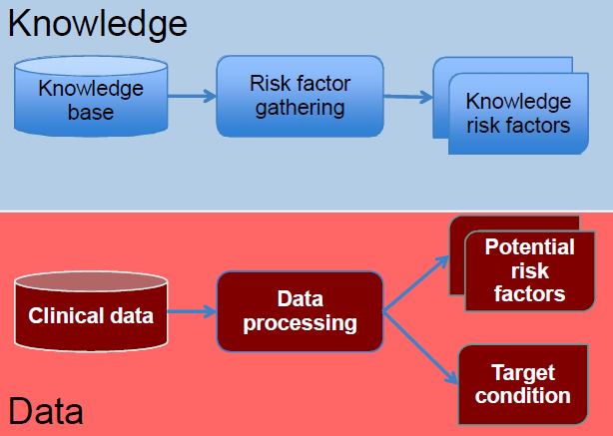
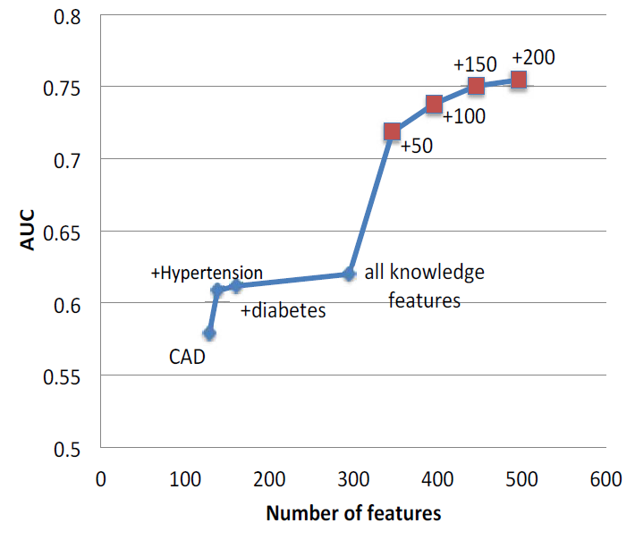
用于疾病预测模型

Slide 20

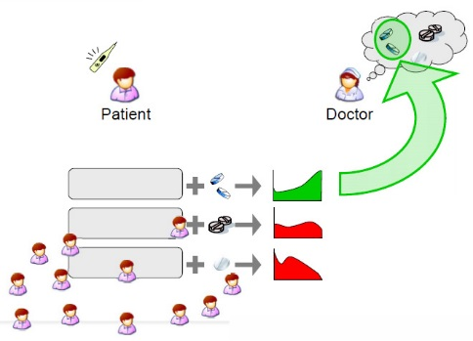

用于临床决策支持
患者
相似性搜索
电子病历数据
从数据库中实时查询与就诊患者临床特征相似的患者
对相似患者进行治疗效果分析，提出最佳治疗方案的建议

Slide 21
Cluster analysis
HF-ACTION (Heart Failure: A Controlled Trial Investigating Outcomes of Exercise Training) study
2331例收缩性心衰患者(NYHA II–IV级,LVEF<35%)
患者被随机分为一般治疗组合运动干预组(structured, group-based, supervised exercise)
J Am Coll Cardiol 2014;64:1765–74

Slide 22
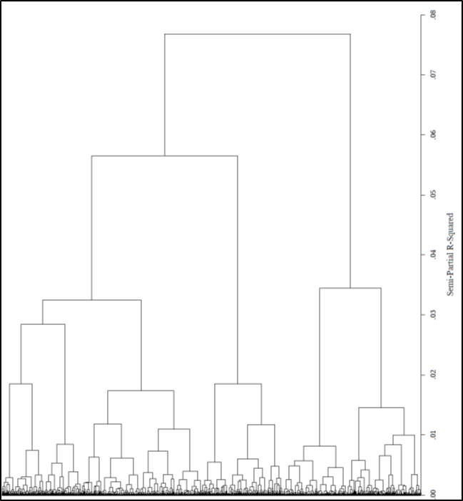
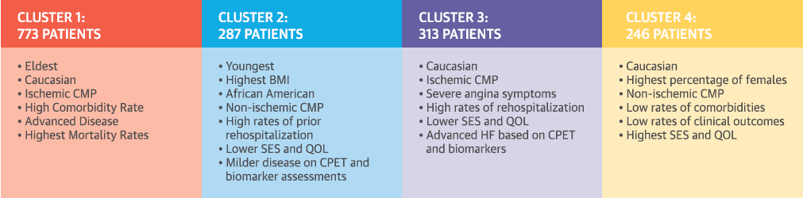
Patient Characteristics | Age, Sex, Race, Weight, BMI, Systolic BP, Diastolic BP, Smoking Status, Alcohol Use, NYHA class, CCS angina class, LV Ejection Fraction, Number of Recent HF Hospitalizations, Resting Heart Rate
Past Medical History | Ischemic Heart Disease, Angina, Atrial Fibrillation/Flutter, Hypertension, Hyperlipidemia, PVD, Prior MI, Prior Stroke, Diabetes, COPD, Prior CABG, Prior Valve Surgery, Prior PCI, Pacemaker, ICD, Biventricular Pacemaker
Laboratory Values | Sodium, Creatinine, BUN
Quality of Life Assessments | KCCQ overall summary score, KCCQ symptom stability score, KCCQ total symptom score, Beck Depression score
Exercise Variables | 6MWD, Cardiopulmonary Exercise Testing Findings: ECG Ventricular Conduction, Peak HR, Peak VO₂, Peak Respiratory Exchange Ratio, VeVCO₂ Slope, Heart rate at end of test, CPX duration

Slide 23
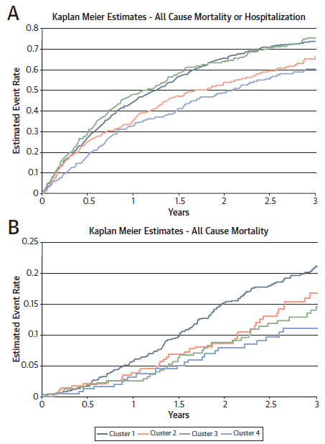
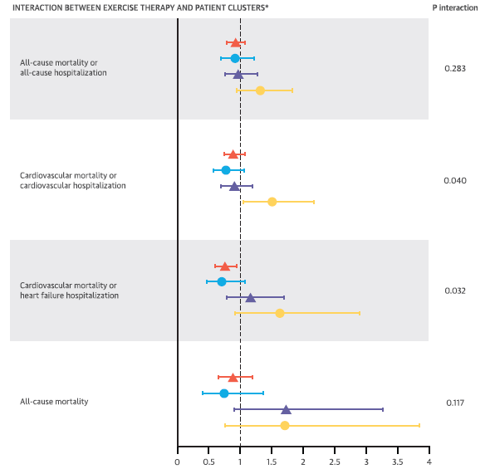
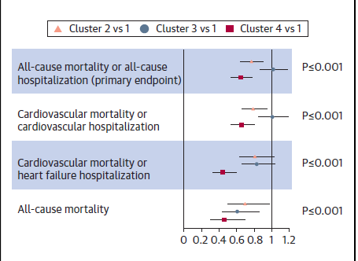

Slide 24

大数据揭示环境对心血管病的影响
1981-2000年90个城市每日总悬浮微粒数据和1991-2000年各年龄段死亡率、预期寿命和死于心肺疾病的数据
TSPs升高100ug/m3，心肺疾病死亡率上升14%，寿命减少3年
冬季取暖致淮河以北TSPs高185ug/m3，预期寿命减少5.5年
TSP：总悬浮颗粒物
PNAS. 2013 Jul 8
Notes:
以取暖分界的淮河为准，选取了淮河以北和以南的90座城市，收集了1981年到2000年间这些城市每日的总悬浮颗粒物浓度数据，以及疾控系统得到的1991年到2000年这些城市的各年龄段死亡率、预期寿命和死于心肺疾病的数据。

Slide 25
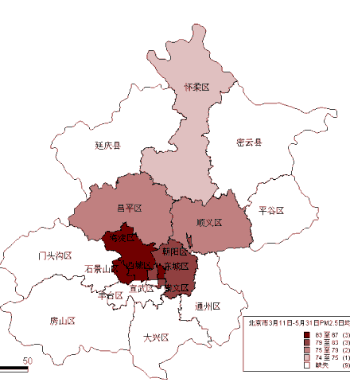
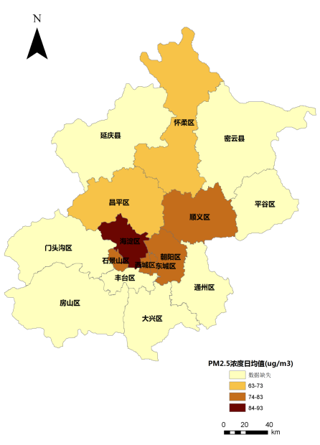
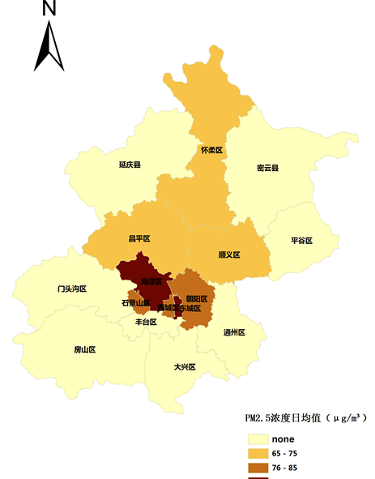
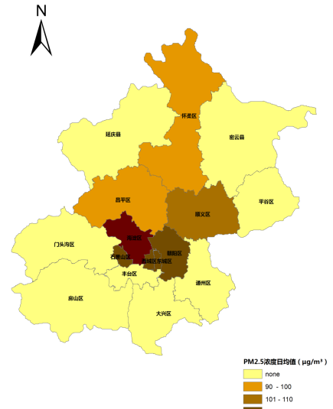
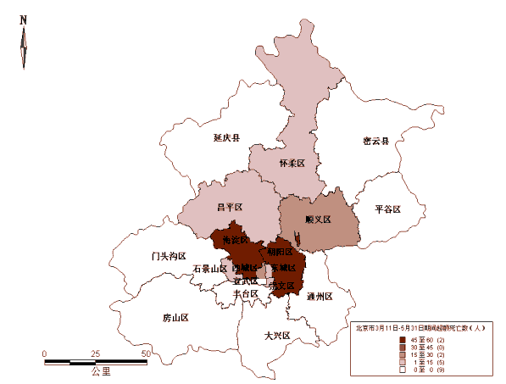
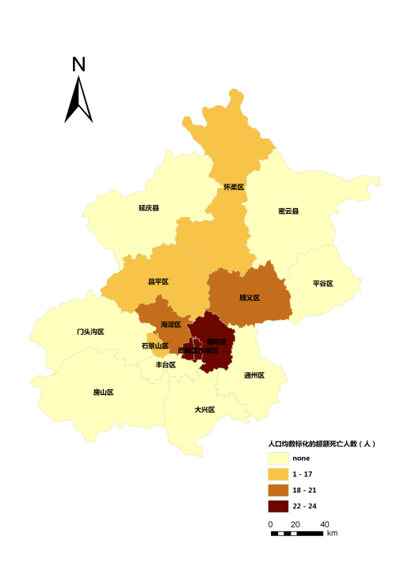
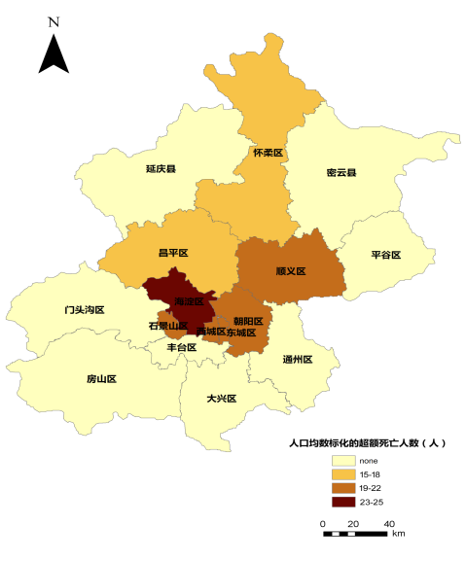
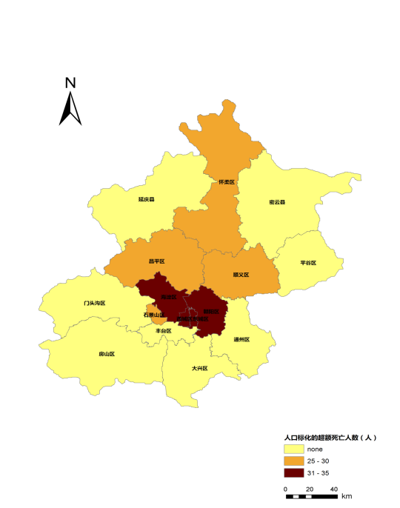
揭示环境因素对心血管病的影响
污染严重且人口密集的区县超额死亡人口数多
去除人口基数影响后，高水平污染仍是健康风险的重要因素
PM_{2.5}浓度分布
春季 夏季 秋季 冬季
超额死亡风险分布

Slide 26
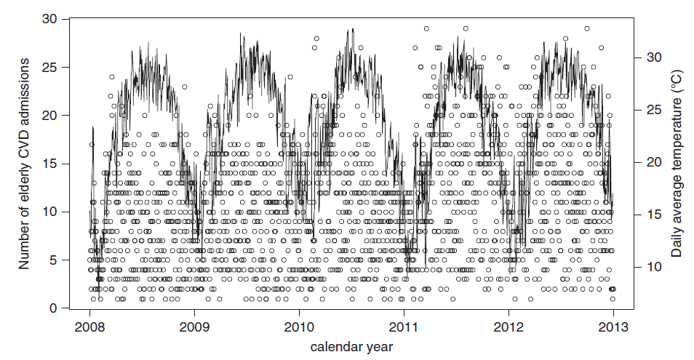
揭示环境因素对心血管病的影响

Slide 27
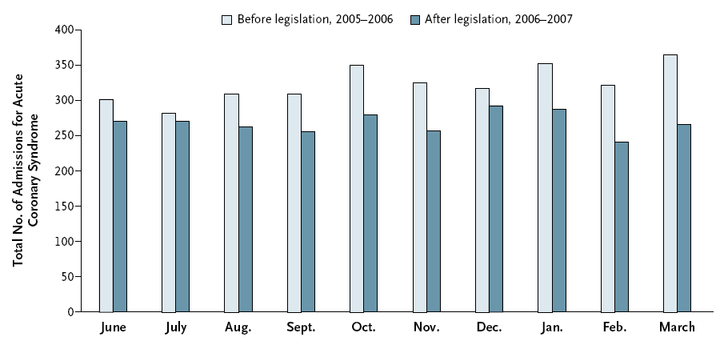
立法公共场所禁烟后ACS住院率下降
指导政府公共卫生决策
2006年3月，苏格兰立法在公共场所戒烟后，比较9家医院1年后同期急性冠脉综合征的住院例数
急性冠脉综合征总数下降了17%，同期英格兰仅下降了4%
NEJM. 2008;359:482
Notes:
Background
Previous studies have suggested a reduction in the total number of hospital admissions for acute coronary syndrome after the enactment of legislation banning smoking in public places. However, it is unknown whether the reduction in admissions involved nonsmokers, smokers, or both.
Full Text of Background...
Methods
Since the end of March 2006, smoking has been prohibited by law in all enclosed public places throughout Scotland. We collected information prospectively on smoking status and exposure to secondhand smoke based on questionnaires and biochemical findings from all patients admitted with acute coronary syndrome to nine Scottish hospitals during the 10-month period preceding the passage of the legislation and during the same period the next year. These hospitals accounted for 64% of admissions for acute coronary syndrome in Scotland, which has a population of 5.1 million.
Full Text of Methods...
Results
Overall, the number of admissions for acute coronary syndrome decreased from 3235 to 2684 — a 17% reduction (95% confidence interval, 16 to 18) — as compared with a 4% reduction in England (which has no such legislation) during the same period and a mean annual decrease of 3% (maximum decrease, 9%) in Scotland during the decade preceding the study. The reduction in the number of admissions was not due to an increase in the number of deaths of patients with acute coronary syndrome who were not admitted to the hospital; this latter number decreased by 6%. There was a 14% reduction in the number of admissions for acute coronary syndrome among smokers, a 19% reduction among former smokers, and a 21% reduction among persons who had never smoked. Persons who had never smoked reported a decrease in the weekly duration of exposure to secondhand smoke (P<0.001 by the chi-square test for trend) that was confirmed by a decrease in their geometric mean concentration of serum cotinine from 0.68 to 0.56 ng per milliliter (P<0.001 by the t-test).
Full Text of Results...
Conclusions
The number of admissions for acute coronary syndrome decreased after the implementation of smoke-free legislation. A total of 67% of the decrease involved nonsmokers. However, fewer admissions among smokers also contributed to the overall reduction.

Slide 28

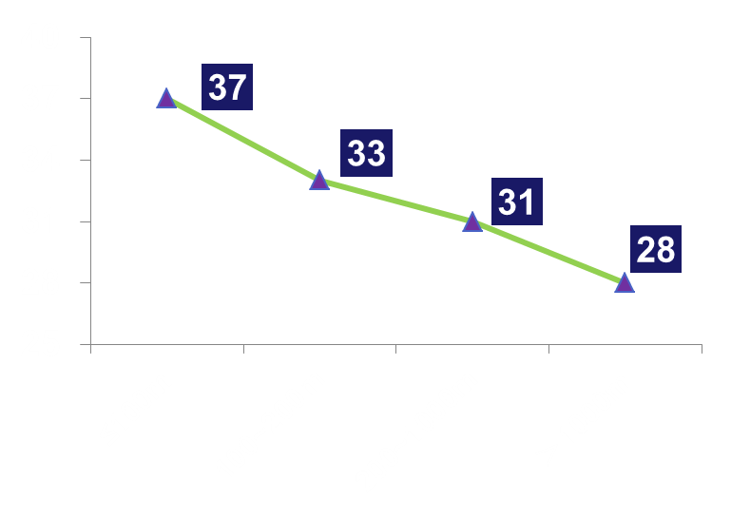
发现危险因素的地理和人群分布特征
全因死亡率
%
BMJ 2008;337:a2338
Circulation 2012; 125: 2197
  发现危险因素的簇集分布，进行有效干预
  全因死亡率与住宅距离主干道的距离相关

Slide 29
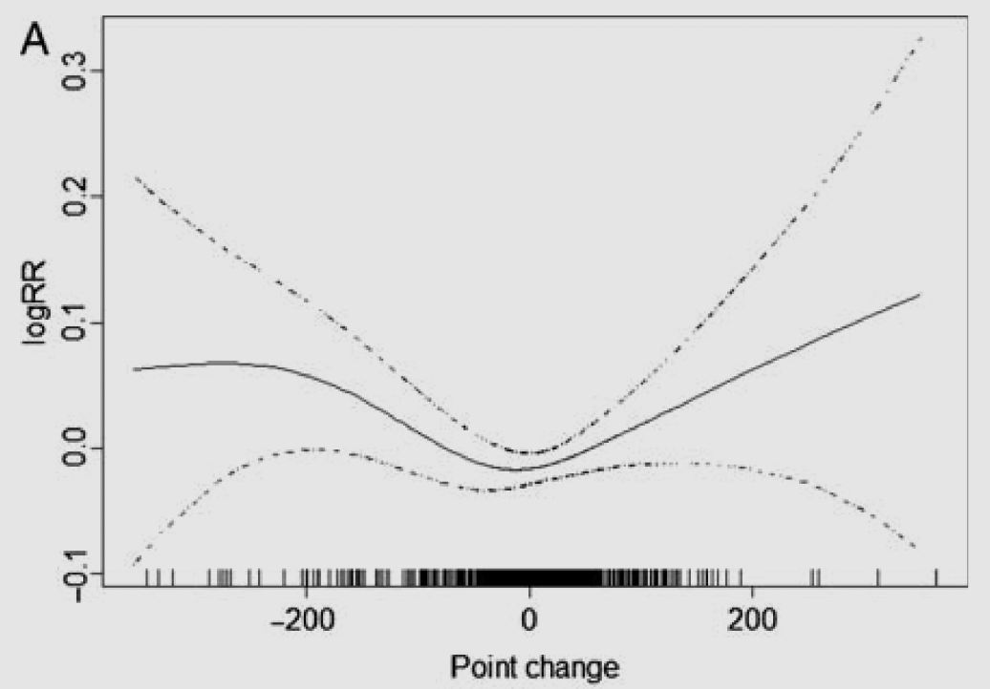
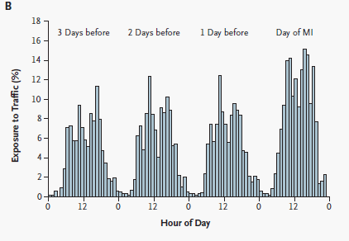
发现影响心血管病的社会因素
EHJ 2011;32:1006
NEJM. 2004;351:1721
股指变化与冠心病死亡呈U型相关
股指每波动100点冠心病死亡风险增加5.17%
患者发病前三天交通暴露百分比
发病前一小时暴露于交通环境与急性心肌梗死相关 (OR=2.92)

Slide 30


大数据平台监测药物安全性
田纳西医保数据库（92-06）
34.8万阿奇霉素，134.9万阿莫西林
FDA警示阿奇霉素的使用
丹麦国民注册（07-10）
169.8万阿奇霉素和1047万青霉素V 处方
HR 1.87 (95% CI, 1.16–3.01)
P=0.01
1000人年
NEJM 2012;366:1881
NEJM 2013;368:1704

Slide 31




建立北京市心血管疾病防控大数据平台
全方位集成心血管疾病相关数据
北京心血管疾病临床研究中心网络平台
住院患者病历首页
首都医科大学心脏病学系22家医院
心血管疾病
大数据平台
CDC死因监测数据
朝阳区卫生局社区卫生服务信息
120/999急救系统
嘉和美康
临床信息系统
环境与社会学公开数据
医疗健康保险数据
涵盖临床资料、死因监测、医疗保险、环境与社会数据

Slide 32
建立全国心血管大数据协作网
A医院EMR
B医院EMR
C医院EMR
心血管数据库
心血管数据库
心血管数据库
心血管数据运营计算平台
向管理委员会提出使用数据申请
平台运营单位获取网络成员单位授权
按平台运营规则收费和付费
应用平台统计功能计算获取统计结果

Slide 33

数据源管理平台
分布式数据存储
统一授权账号管理：针对项目需求授权使用数据
数据源管理平台
授权
授权
授权
授权
授权
代理终端
代理终端
代理终端
代理终端
代理终端
疾病预防
控制中心
公共卫生信息中心
卫生局
急救中心
红十字会
急救中心
Notes:
讲解该平台主要实现什么功能，由于时间关系，只介绍各个部分最核心的问题。

Slide 34
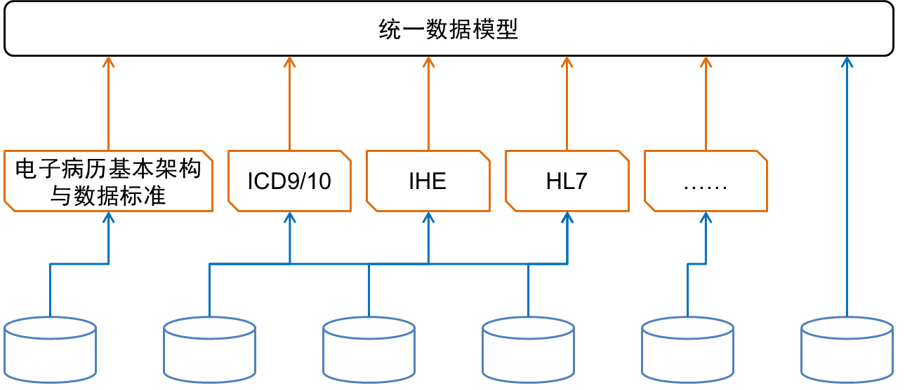
数据融合平台
采用国际国内数据标准，将各数据源数据转换为可融合数据
统一数据使用标准
疾病预防
控制中心
公共卫生信息中心
卫生局
急救中心
红十字会
急救中心
… …

Slide 35
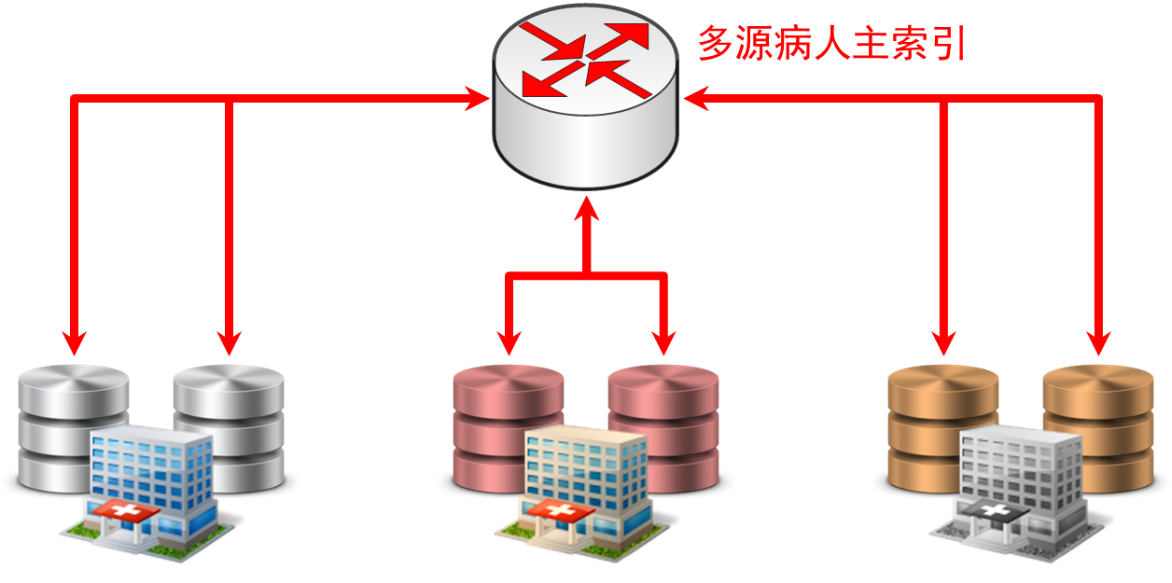
数据融合平台
建立多源病人主索引（MMPI），将存在于不同数据源中的同一患者信息串联起来

Slide 36
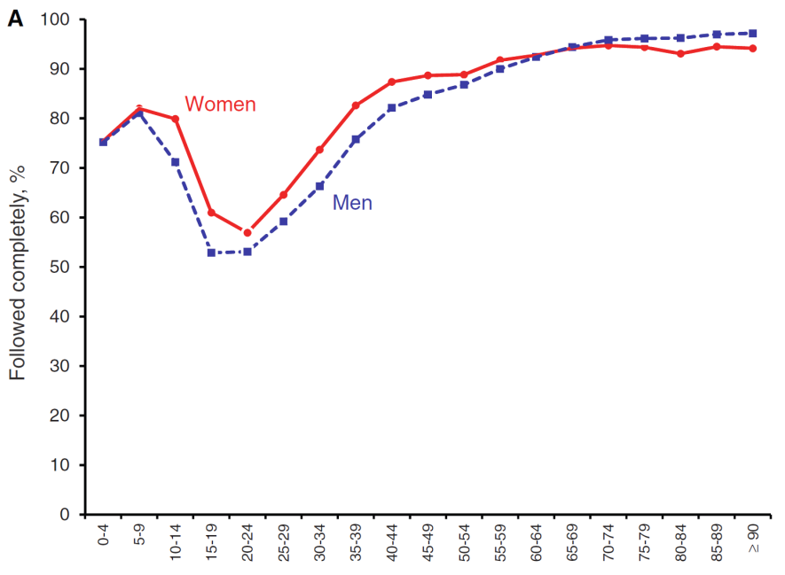
临床研究数据库
罗切斯特流行病学项目
链接全县不同诊所和医院诊断和治疗资料
1966年建立于明尼苏达Olmsted
含1966年1月1日至今50万人的就诊记录（600万随访人年）
NIH持续资助，目前在研项目253项
Olmsted居民的随访率
Olmsted与外界相对隔离，居民均在本地就诊

Slide 37
谢谢！

